Slide 1
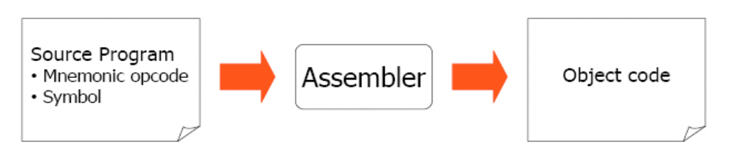
Assembler: Definition
Translating source code written in assembly language to object code.

Slide 2
Language Levels
High Level Language
Assembler Language
Machine Language
Micro -programming
Firmware
Hardware

Slide 3
Elements of the Assembly Language Programming
An Assembly language is a
  machine dependent,
  low level Programming language specific to a certain computer system.
Three features when compared with machine language are
Mnemonic Operation Codes
Symbolic operands
Data declarations

Slide 4
Elements of the Assembly Language Programming
Mnemonic operation codes: eliminates the need to memorize numeric operation codes.
Symbolic operands: Symbolic names can be associated with data or instructions. Symbolic names can be used as operands in assembly statements (need not know details of memory bindings).
Data declarations: Data can be declared in a variety of notations, including the decimal notation (avoids conversion of constants into their internal representation). For e.g -5 into 111111010

Slide 5
Assembly language-structure
<Label>
<Mnemomic>
<Operand>
Comments
Label
  symbolic labeling of an assembler address (command address at Machine level)
Mnemomic
  Symbolic description of an operation
Operands
  Contains of variables or addresse if necessary
Comments

Slide 6
Statement format
An Assembly language statement has following format:
[Label] <opcode> <operand spec>[,<operand spec>..]
If a label is specified in a statement, it is associated as a symbolic name with the memory word generated for the statement.
<operand spec> has the following syntax:
<symbolic name> [+<displacement>] [(<index register>)]
Eg. AREA, AREA+5, AREA(4), AREA+5(4)

Slide 7
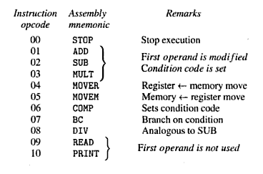
Mnemonic Operation Codes
Each statement has two operands, first operand is always a register and second operand refers to a memory word using a symbolic name and optional displacement.

Slide 8
Operation Codes
All arithmetic is performed in a register (replaces the contents of a register) and sets condition code.
A Comparision instruction sets condition code analogous to arithmetics, i.e. without affecting values of operands.
condition code can be tested by a Branch on Condition (BC) instruction and the format is:
BC <condition code spec> , <memory address>
Conditional codes specification are
LT | LE | EQ | GT | GE | ANY
1 | 2 | 3 | 4 | 5 | 6

Slide 9

Machine Instruction Format
sign is not a part of the instruction
Opcode: 2 digits, Register Operand: 1 digit, Memory Operand: 3 digits
Condition code specified in a BC statement is encoded into the first operand using the codes 1- 6 for specifications LT, LE, EQ, GT, GE and ANY respectively
In a Machine Language Program, all addresses and constants are shown in decimal as shown in the next slide

Slide 10
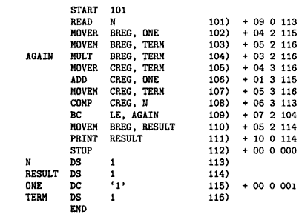
Example: ALP and its equivalent Machine Language Program

Slide 11
Assembly Language Statements
An assembly program contains three kinds of statements:
Imperative Statements
Declaration Statements
Assembler Directives
Imperative Statements: They indicate an action to be performed during the execution of an assembled program.
Each imperative statement is translated into one machine instruction.

Slide 12
Assembly Language Statements
Declaration Statements: syntax is as follows:
[Label] DS <constant>
[Label] DC '<value>'
The DS (declare storage) statement reserves memory and associates names with them.
Ex: A DS 1 ; reserves a memory area of 1 word, associating
the name A to it
G DS 200 ; reserves a block of 200 words and the name G
is associated to it
The DC (declare constant) statement constructs memory words containing constants.
Ex: ONE DC '1’ ; associates name one with a memory word
containing value 1

Slide 13
Assembly Language Statements
Use of Constants
The DC statement does not really implement constants
it just initializes memory words to given values.
The values are not protected by the assembler and can be changed by moving a new value into the memory word.
In the above example, the value of ONE can be changed by executing an instruction
MOVEM BREG, ONE

Slide 14
Assembly Language Statements
Use of Constants
An Assembly Program can use constants just like HLL, in two ways – as immediate operands, and as literals.
1) Immediate operands can be used in an assembly statement only if the architecture of the target machine includes the necessary features.
  Ex: ADD AREG,5
  This is translated into an instruction from two operands – AREG and the value '5' as an immediate operand

Slide 15
Assembly Language Statements
Use of Constants
2) A literal is an operand with the syntax = '<value>'.
It differs from a constant because its location cannot be specified in the assembly program.
Its value does not change during the execution of the program.
It differs from an immediate operand because no architectural provision is needed to support its use.
ADD AREG, =‘5’ ➔ ADD AREG, FIVE
FIVE DC ‘5’

Slide 16
Assembly Language Statements
Assembler Directive
Assembler directives instruct the assembler to perform certain actions during the assembly of a program.
Some assembler directives are described in the following:
1) START <constant>
This directive indicates that the first word of the target program generated by the assembler should be placed in the memory word having address <constant>.
2) END [<operand spec>]
This directive indicates the end of the of the source program. The optional <operand spec> indicates the address of the instruction where the execution of the program should begin.

Slide 17
A simple Assembly Scheme
There are two phases in specifying an assembler:
Analysis Phase
Synthesis Phase(the fundamental information requirements will arise in this phase)

Slide 18
A simple Assembly Scheme
Design Specification of an assembler
There are four steps involved to design the specification of an assembler:
Identify information necessary to perform a task.
Design a suitable data structure to record info.
Determine processing necessary to obtain and maintain the info.
Determine processing necessary to perform the task

Slide 19
Data structures in synthesis phase
Symbol Table -- built by the analysis phase
  The two primary fields are name and address of the symbol used to specify a value.
Mnemonics Table -- already present
  The two primary fields are mnemonic and opcode, along with length.
Synthesis phase uses these tables to obtain
  The machine address with which a name is associated.
  The machine op code corresponding to a mnemonic.
The tables have to be searched with the
  Symbol name and the mnemonic as keys

Slide 20
Analysis Phase
Primary function of the Analysis phase is to build the symbol table.
To implement memory allocation a data structure called location counter is introduced.

Slide 21
Data structures of an assembler During analysis and Synthesis phases
Mnemonic | Opcode | length
ADD | 01 | 1
SUB | 02 | 1
Mnemonic Table
Source
Program
Target
Program
Analysis Phase
Synthesis
Phase
--------------------------------->
Symbol | Address
N | 113
AGAIN | 104
Data Access
-- > Control Access
Symbol Table

Slide 22
Design Of TWO PASS ASSEMBLER
First pass:
  Scan the code by separating the symbol, mnemonic op code and operand fields
  Build the symbol table
  Perform LC processing
  Construct intermediate representation
Second Pass:
  Solves forward references
  Converts the code to the machine code

Slide 23
Single Pass Translation
The operand field of an instruction containing a forward reference is left blank initially.
The address of the forward referenced symbol is put into this field when its definition is encountered.
e.g In program instruction corresponding to the statement
MOVER BREG , ONE
Can be partially synthesized, since ONE is a forward reference. Hence the instruction opcode and address of BREG will be assembled to reside in Location 101

Slide 24
The need for inserting the second operand address at a later stage can be indicated by adding an entry to the Table Of Incomplete Instructions (TII)
This entry is a pair ( <Instruction address>, <Symbol> )
E.g (101 , ONE).
By the time END statement is processed , the symbol table would contain the address of all symbol defined in the source program and TTI would contain information describing all forward references.
The assembler can now process each entry in TII to complete the concerned instruction.

Slide 25
Advanced Assembler Directives
ORIGIN
syntax : ORIGIN < address Specification >
This directive indicates that LC should be set to address given by <address spec >
EQU
syntax : <Symbol> EQU < address Specification >
EQU statement defines the symbol to represent <address spec >

Slide 26
Advanced Assembler Directives
LTROG
The LTORG statement permits a programmer to specify where literals should be placed.
At every, LTORG statement, as also the END stmt the assembler allocated memory to the literals of the literal pool.

Slide 27

PROBLEM

Slide 28
Data Structures in Pass I
OPTAB
A table of mnemonic opcode and related information.
Mnemonic Opcode | Class | Mnemonic Info
MOVER | IS | (04 , 1 )
DS | DL | R # 7
START | AD | R # 11
……..
………

Slide 29
  Contains mnemonic op code, class and mnemonic info
  Class field indicates whether the op code corresponds to
    an imperative statement (IS),
    a declaration statement (DL) or
    an assembler Directive (AD)
  For IS, mnemonic info field contains the pair ( machine opcode, instruction length)
  Else, it contains the id of the routine to handle the declaration or a directive statement
  The routine processes the operand field of the statement to determine the amount of memory required and updates LC and the SYMTAB entry of the symbol defined

Slide 30
Data Structures in Pass I
SYMTAB
Symbol Table
Symbol | Address | Length
LOOP | 202 | 1
NEXT | 214 | 1
LAST | 216 | 1
A | 217 | 1
BACK | 202 | 1
B | 218 | 1

Slide 31
Data Structures in Pass I
LITTAB
A table of literals used in the program
LITERAL ADDRESS
=‘5’
=‘1’
=‘1’

Slide 32
Data Structures in Pass I
POOLTAB
LITERAL NO
# 1
#3

Slide 33
Assembler Pass I algorithm

Slide 34
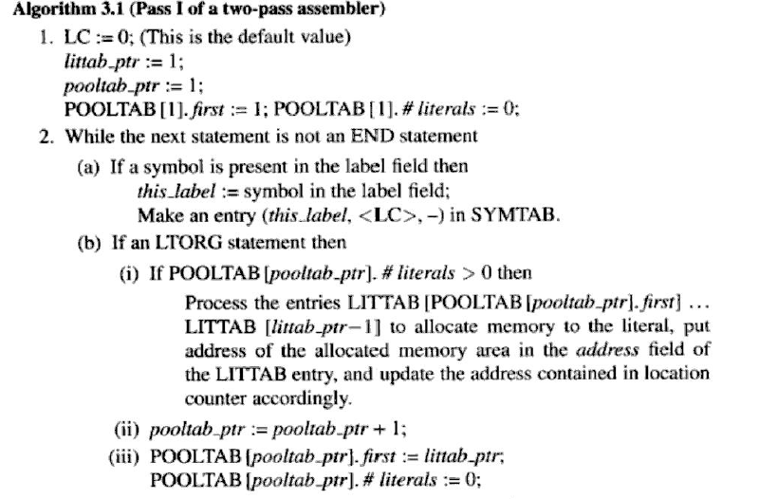

Slide 35
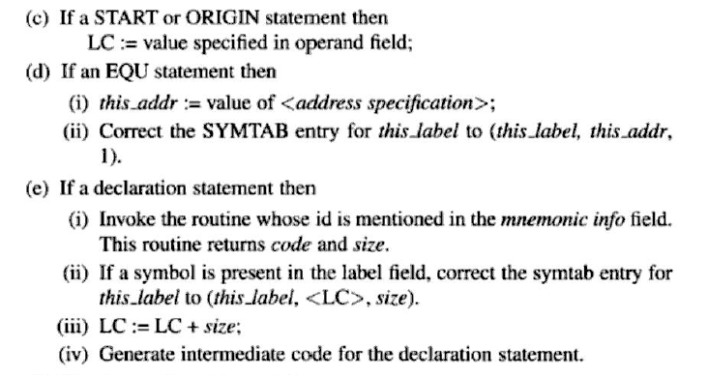

Slide 36
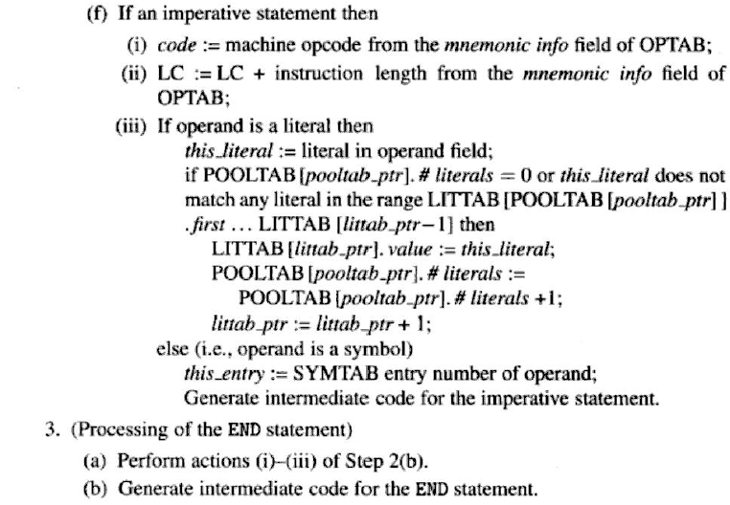

Slide 37
Assembler Pass II algorithm

Slide 38
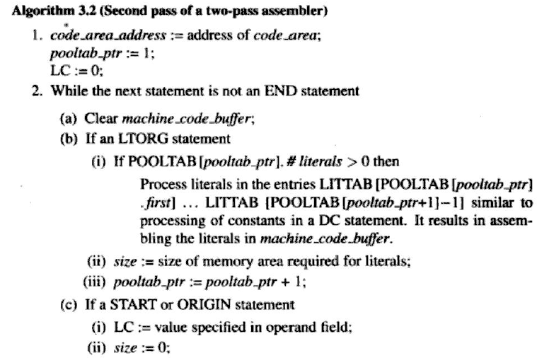

Slide 39
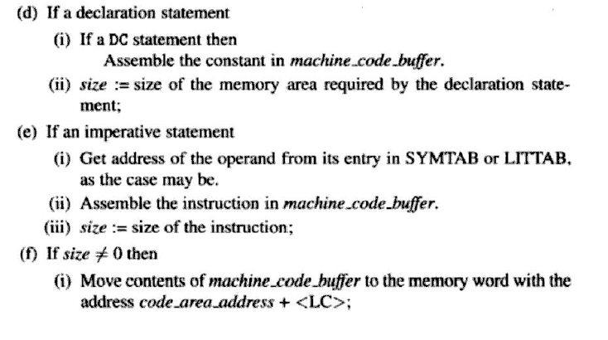

Slide 40
